Slide 1

Presents
CKD/PKD-Friendly Recipe Deminar*
Dietitian Discussion Of PKD Dietary Recommendations Followed By A Cooking Demonstration
Featuring
Misty Nason,RD,CSR,CD & Chef Duane Sunwold
Moderated By
Molly Jansen,PhD
*Cooking Demonstration & Webinar
January 2023 US.CORP.D.23.00002
Notes:
Speak to slide.

Slide 2
This program is paid for by
Otsuka Pharmaceutical Development & Commercialization, Inc.
Speakers are employees and/or paid consultants of
Otsuka Pharmaceutical Development & Commercialization, Inc.
Notes:
Speak to slide.

Slide 3
Notes:
Speak to slide

Slide 4
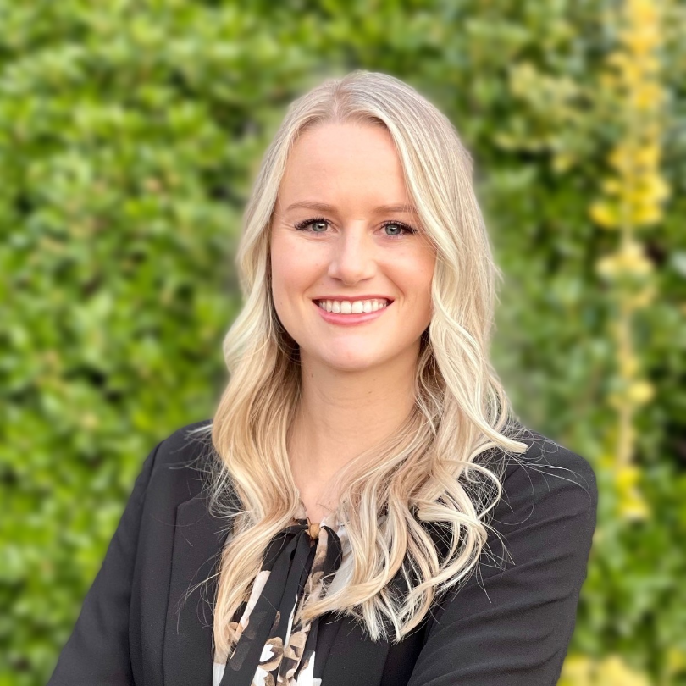


Presenters
Molly Jansen, PhD
Nephrology Clinical & Scientific Liaison
Otsuka Pharmaceutical Development & Commercialization, Inc.
Misty Nason, RD, CSR, CD
Registered Dietitian & Nutritionist
Founder, Viva Nutrition Counseling, LLC
Duane Sunwold
Culinary Expert
Culinary Arts Faculty, Chef & Cooking Demonstrator
Notes:
Speak to slide

Slide 5
Objectives
Diet Recommendations for Early Stages of PKD
  Protein, Salt, Phosphorus, Potassium, Fat
  Water Intake, Caloric Restriction
  7 Strategies to Implement
Cooking Demonstration with Chef Duane
  Curried Chicken, Rice, and Pineapple Salad
  Rice Milk Sorbet
  Fresh Plum Compote
Notes:
Speak to slide

Slide 6
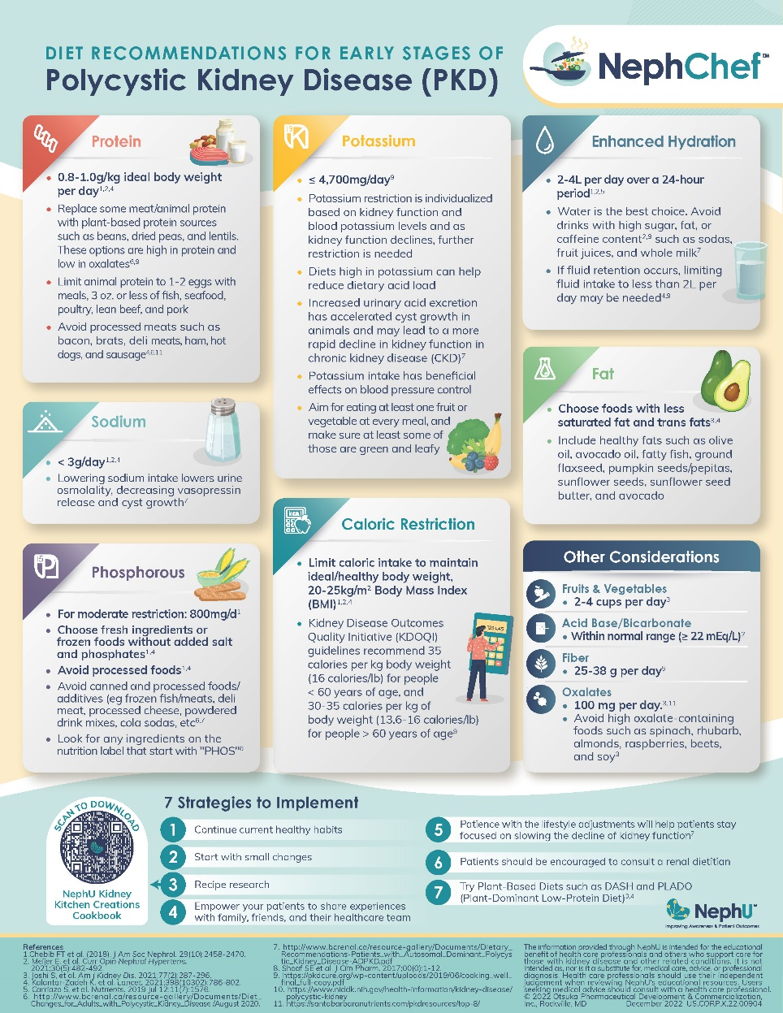
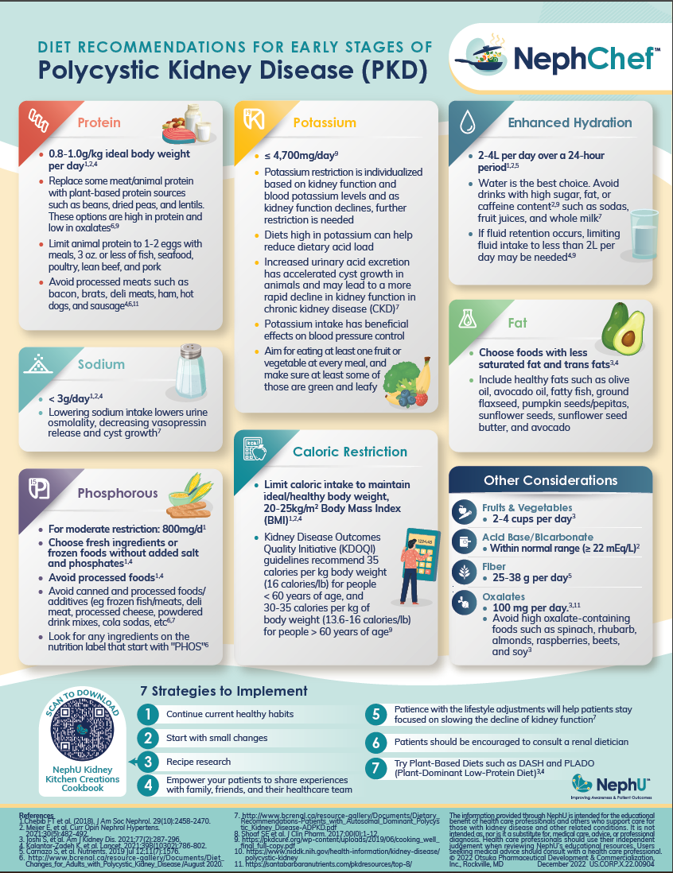
Infographic – Diet Recommendations For Early Stages Of Polycystic Kidney Disease (PKD)
Notes:
Speak to slide

Slide 7

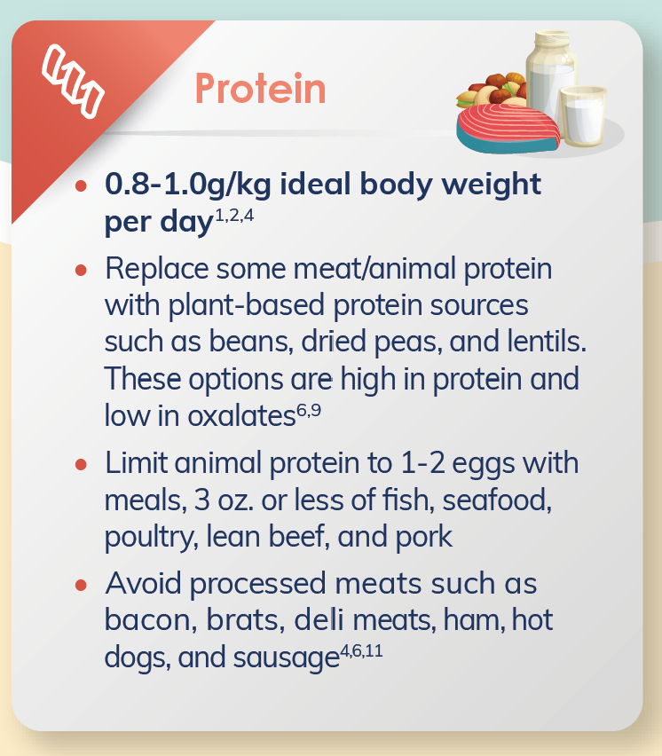
1.Chebib FT et al. (2018). J Am Soc Nephrol. 29(10):2458-2470. 2. Meijer E, et al. Curr Opin Nephrol Hypertens. 2021;30(5):482-492. 3. Joshi S, et al. Am J Kidney Dis. 2021;77(2):287-296. 4. Kalantar-Zadeh K. et al. Lancet. 2021;398(10302):786-802. 5. Carriazo S, et al. Nutrients. 2019 Jul 12;11(7):1576. 6. http://www.bcrenal.ca/resource-gallery/Documents/Diet_ Changes_for_Adults_with_Polycystic_Kidney_Disease /August 2020. 7. http://www.bcrenal.ca/resource-gallery/Documents/Dietary_ Recommendations-Patients_with_Autosomal_Dominant_Polycys tic_Kidney_Disease-ADPKD.pdf 8. Shoaf SE et al. J Clin Pharm. 2017;00(0):1-12. 9. https://pkdcure.org/wp-content/uploads/2019/06/cooking_well_ final_full-copy.pdf 10. https://www.niddk.nih.gov/health-information/kidney-disease/ polycystic-kidney 11. https://santabarbaranutrients.com/pkdresources/top-8/
Notes:
Speak to slide

Slide 8
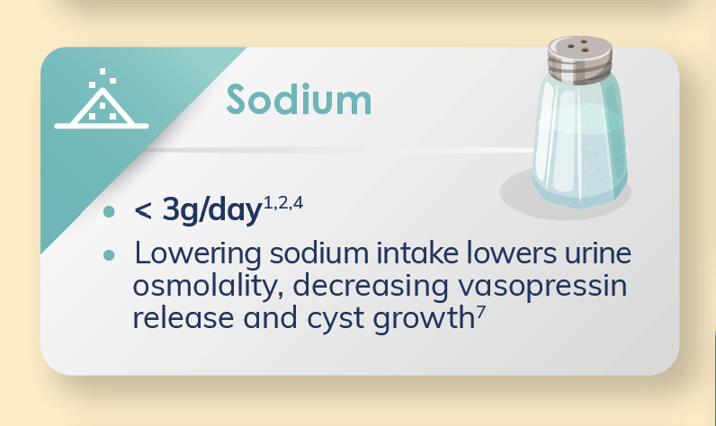
1.Chebib FT et al. (2018). J Am Soc Nephrol. 29(10):2458-2470. 2. Meijer E, et al. Curr Opin Nephrol Hypertens. 2021;30(5):482-492. 3. Joshi S, et al. Am J Kidney Dis. 2021;77(2):287-296. 4. Kalantar-Zadeh K. et al. Lancet. 2021;398(10302):786-802. 5. Carriazo S, et al. Nutrients. 2019 Jul 12;11(7):1576. 6. http://www.bcrenal.ca/resource-gallery/Documents/Diet_ Changes_for_Adults_with_Polycystic_Kidney_Disease /August 2020. 7. http://www.bcrenal.ca/resource-gallery/Documents/Dietary_ Recommendations-Patients_with_Autosomal_Dominant_Polycys tic_Kidney_Disease-ADPKD.pdf 8. Shoaf SE et al. J Clin Pharm. 2017;00(0):1-12. 9. https://pkdcure.org/wp-content/uploads/2019/06/cooking_well_ final_full-copy.pdf 10. https://www.niddk.nih.gov/health-information/kidney-disease/ polycystic-kidney 11. https://santabarbaranutrients.com/pkdresources/top-8/
Notes:
Speak to slide

Slide 9
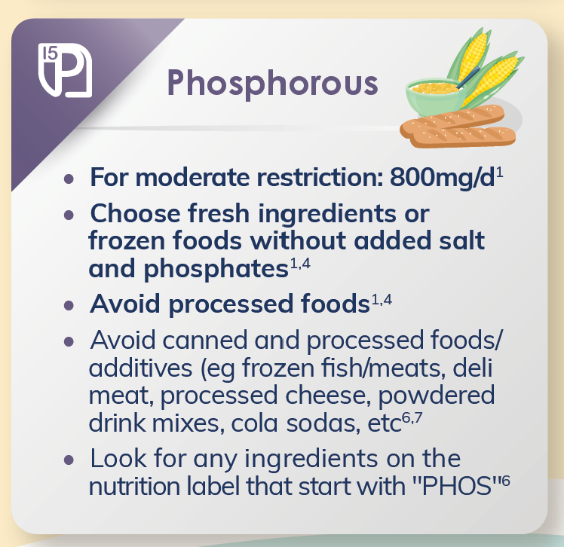
1.Chebib FT et al. (2018). J Am Soc Nephrol. 29(10):2458-2470. 2. Meijer E, et al. Curr Opin Nephrol Hypertens. 2021;30(5):482-492. 3. Joshi S, et al. Am J Kidney Dis. 2021;77(2):287-296. 4. Kalantar-Zadeh K. et al. Lancet. 2021;398(10302):786-802. 5. Carriazo S, et al. Nutrients. 2019 Jul 12;11(7):1576. 6. http://www.bcrenal.ca/resource-gallery/Documents/Diet_ Changes_for_Adults_with_Polycystic_Kidney_Disease /August 2020. 7. http://www.bcrenal.ca/resource-gallery/Documents/Dietary_ Recommendations-Patients_with_Autosomal_Dominant_Polycys tic_Kidney_Disease-ADPKD.pdf 8. Shoaf SE et al. J Clin Pharm. 2017;00(0):1-12. 9. https://pkdcure.org/wp-content/uploads/2019/06/cooking_well_ final_full-copy.pdf 10. https://www.niddk.nih.gov/health-information/kidney-disease/ polycystic-kidney 11. https://santabarbaranutrients.com/pkdresources/top-8/
Notes:
Speak to slide

Slide 10
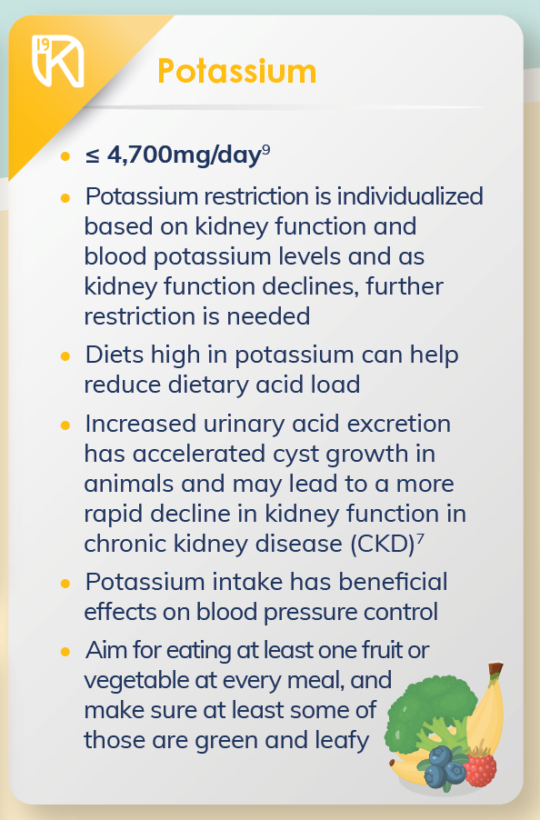
1.Chebib FT et al. (2018). J Am Soc Nephrol. 29(10):2458-2470. 2. Meijer E, et al. Curr Opin Nephrol Hypertens. 2021;30(5):482-492. 3. Joshi S, et al. Am J Kidney Dis. 2021;77(2):287-296. 4. Kalantar-Zadeh K. et al. Lancet. 2021;398(10302):786-802. 5. Carriazo S, et al. Nutrients. 2019 Jul 12;11(7):1576. 6. http://www.bcrenal.ca/resource-gallery/Documents/Diet_ Changes_for_Adults_with_Polycystic_Kidney_Disease /August 2020. 7. http://www.bcrenal.ca/resource-gallery/Documents/Dietary_ Recommendations-Patients_with_Autosomal_Dominant_Polycys tic_Kidney_Disease-ADPKD.pdf 8. Shoaf SE et al. J Clin Pharm. 2017;00(0):1-12. 9. https://pkdcure.org/wp-content/uploads/2019/06/cooking_well_ final_full-copy.pdf 10. https://www.niddk.nih.gov/health-information/kidney-disease/ polycystic-kidney 11. https://santabarbaranutrients.com/pkdresources/top-8/
Notes:
Speak to slide

Slide 11
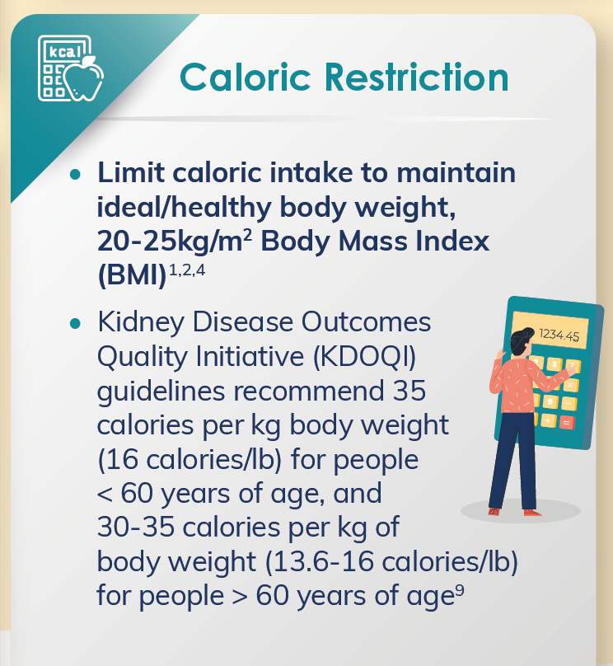
Chebib FT et al. (2018). J Am Soc Nephrol. 29(10):2458-2470. 2. Meijer E, et al. Curr Opin Nephrol Hypertens. 2021;30(5):482-492. 3. Joshi S, et al. Am J Kidney Dis. 2021;77(2):287-296. 4. Kalantar-Zadeh K. et al. Lancet. 2021;398(10302):786-802. 5. Carriazo S, et al. Nutrients. 2019 Jul 12;11(7):1576. 6. http://www.bcrenal.ca/resource-gallery/Documents/Diet_ Changes_for_Adults_with_Polycystic_Kidney_Disease /August 2020. 7. http://www.bcrenal.ca/resource-gallery/Documents/Dietary_ Recommendations-Patients_with_Autosomal_Dominant_Polycys tic_Kidney_Disease-ADPKD.pdf 8. Shoaf SE et al. J Clin Pharm. 2017;00(0):1-12. 9. https://pkdcure.org/wp-content/uploads/2019/06/cooking_well_ final_full-copy.pdf 10. https://www.niddk.nih.gov/health-information/kidney-disease/ polycystic-kidney 11. https://santabarbaranutrients.com/pkdresources/top-8/
Notes:
Speak to slide

Slide 12
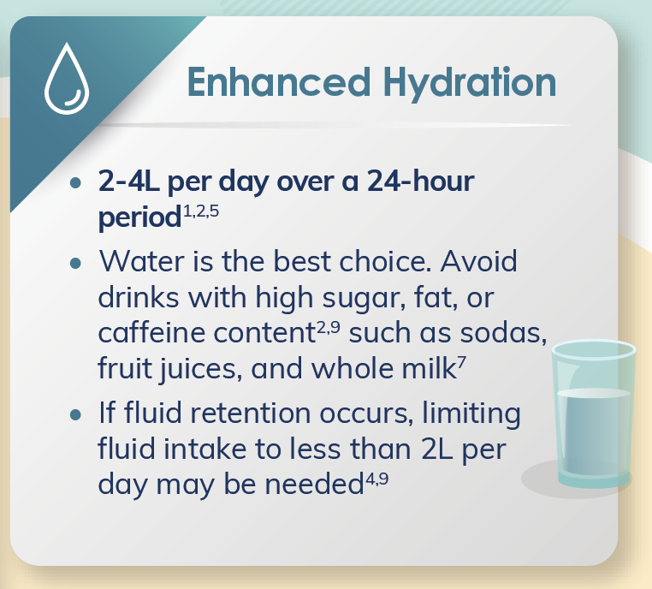
Chebib FT et al. (2018). J Am Soc Nephrol. 29(10):2458-2470. 2. Meijer E, et al. Curr Opin Nephrol Hypertens. 2021;30(5):482-492. 3. Joshi S, et al. Am J Kidney Dis. 2021;77(2):287-296. 4. Kalantar-Zadeh K. et al. Lancet. 2021;398(10302):786-802. 5. Carriazo S, et al. Nutrients. 2019 Jul 12;11(7):1576. 6. http://www.bcrenal.ca/resource-gallery/Documents/Diet_ Changes_for_Adults_with_Polycystic_Kidney_Disease /August 2020. 7. http://www.bcrenal.ca/resource-gallery/Documents/Dietary_ Recommendations-Patients_with_Autosomal_Dominant_Polycys tic_Kidney_Disease-ADPKD.pdf 8. Shoaf SE et al. J Clin Pharm. 2017;00(0):1-12. 9. https://pkdcure.org/wp-content/uploads/2019/06/cooking_well_ final_full-copy.pdf 10. https://www.niddk.nih.gov/health-information/kidney-disease/ polycystic-kidney 11. https://santabarbaranutrients.com/pkdresources/top-8/
Notes:
Speak to slide

Slide 13
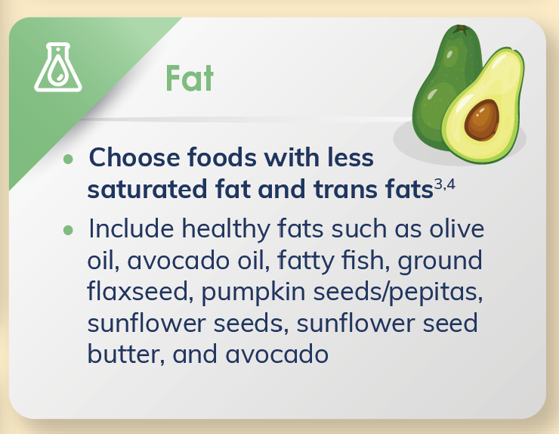
1.Chebib FT et al. (2018). J Am Soc Nephrol. 29(10):2458-2470. 2. Meijer E, et al. Curr Opin Nephrol Hypertens. 2021;30(5):482-492. 3. Joshi S, et al. Am J Kidney Dis. 2021;77(2):287-296. 4. Kalantar-Zadeh K. et al. Lancet. 2021;398(10302):786-802. 5. Carriazo S, et al. Nutrients. 2019 Jul 12;11(7):1576. 6. http://www.bcrenal.ca/resource-gallery/Documents/Diet_ Changes_for_Adults_with_Polycystic_Kidney_Disease /August 2020. 7. http://www.bcrenal.ca/resource-gallery/Documents/Dietary_ Recommendations-Patients_with_Autosomal_Dominant_Polycys tic_Kidney_Disease-ADPKD.pdf 8. Shoaf SE et al. J Clin Pharm. 2017;00(0):1-12. 9. https://pkdcure.org/wp-content/uploads/2019/06/cooking_well_ final_full-copy.pdf 10. https://www.niddk.nih.gov/health-information/kidney-disease/ polycystic-kidney 11. https://santabarbaranutrients.com/pkdresources/top-8/
Notes:
Speak to slide

Slide 14
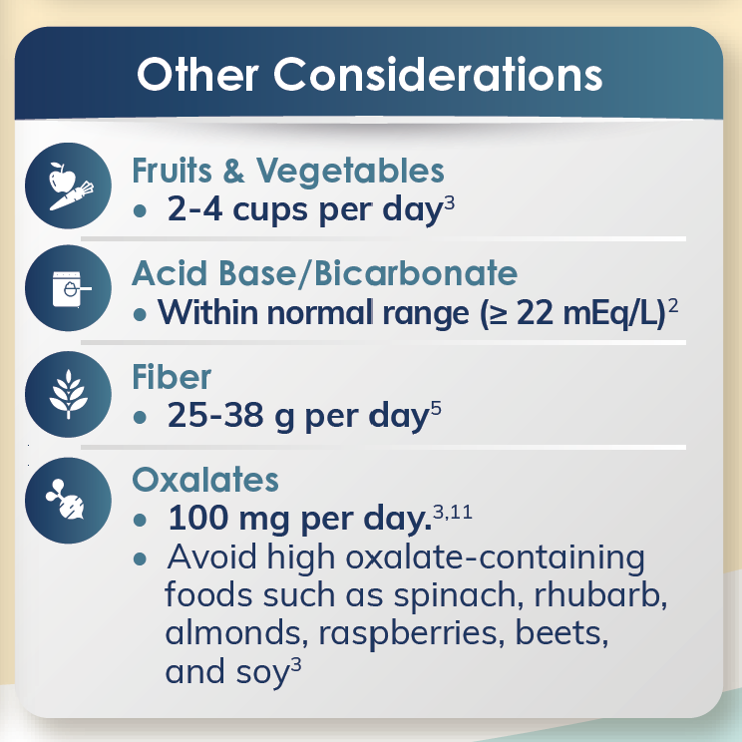
1.Chebib FT et al. (2018). J Am Soc Nephrol. 29(10):2458-2470. 2. Meijer E, et al. Curr Opin Nephrol Hypertens. 2021;30(5):482-492. 3. Joshi S, et al. Am J Kidney Dis. 2021;77(2):287-296. 4. Kalantar-Zadeh K. et al. Lancet. 2021;398(10302):786-802. 5. Carriazo S, et al. Nutrients. 2019 Jul 12;11(7):1576. 6. http://www.bcrenal.ca/resource-gallery/Documents/Diet_ Changes_for_Adults_with_Polycystic_Kidney_Disease /August 2020. 7. http://www.bcrenal.ca/resource-gallery/Documents/Dietary_ Recommendations-Patients_with_Autosomal_Dominant_Polycys tic_Kidney_Disease-ADPKD.pdf 8. Shoaf SE et al. J Clin Pharm. 2017;00(0):1-12. 9. https://pkdcure.org/wp-content/uploads/2019/06/cooking_well_ final_full-copy.pdf 10. https://www.niddk.nih.gov/health-information/kidney-disease/ polycystic-kidney 11. https://santabarbaranutrients.com/pkdresources/top-8/
Notes:
Speak to slide

Slide 15
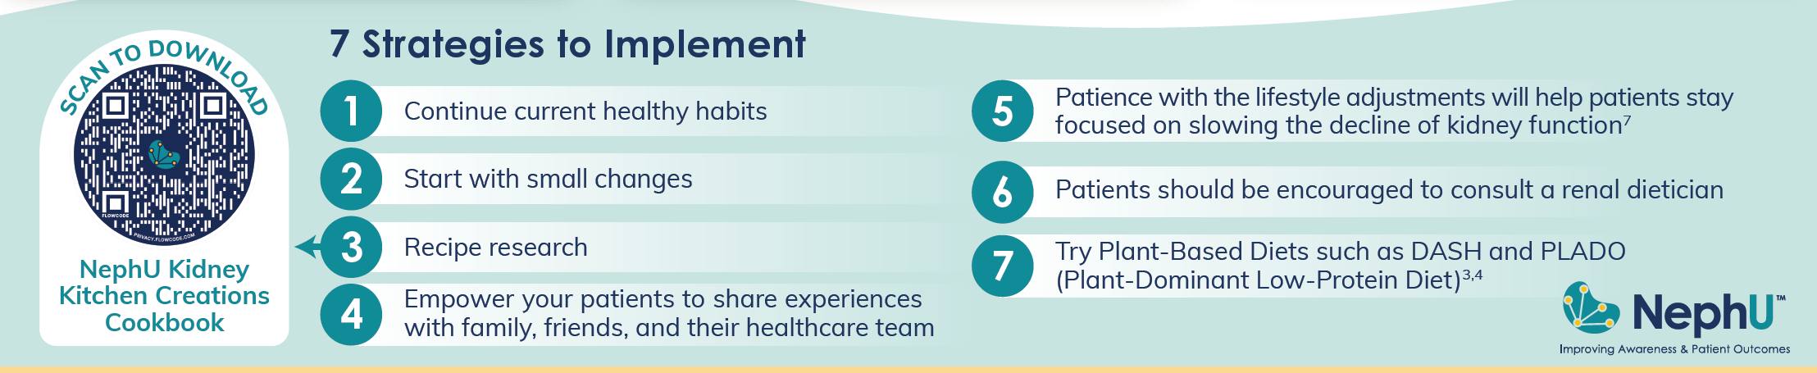
1.Chebib FT et al. (2018). J Am Soc Nephrol. 29(10):2458-2470. 2. Meijer E, et al. Curr Opin Nephrol Hypertens. 2021;30(5):482-492. 3. Joshi S, et al. Am J Kidney Dis. 2021;77(2):287-296. 4. Kalantar-Zadeh K. et al. Lancet. 2021;398(10302):786-802. 5. Carriazo S, et al. Nutrients. 2019 Jul 12;11(7):1576. 6. http://www.bcrenal.ca/resource-gallery/Documents/Diet_ Changes_for_Adults_with_Polycystic_Kidney_Disease /August 2020. 7. http://www.bcrenal.ca/resource-gallery/Documents/Dietary_ Recommendations-Patients_with_Autosomal_Dominant_Polycys tic_Kidney_Disease-ADPKD.pdf 8. Shoaf SE et al. J Clin Pharm. 2017;00(0):1-12. 9. https://pkdcure.org/wp-content/uploads/2019/06/cooking_well_ final_full-copy.pdf 10. https://www.niddk.nih.gov/health-information/kidney-disease/ polycystic-kidney 11. https://santabarbaranutrients.com/pkdresources/top-8/
Notes:
Speak to slide

Slide 16
Cooking Demonstration
Notes:
Speak to slide

Slide 17





Like What You Learned Today? See What’s Up Next!
NephU.org/events
NephU.org/events
The NephU Community Grows Stronger When You’re Engaged.
Follow Us @NephUCommunity
Notes:
Speak to slide.

Slide 18

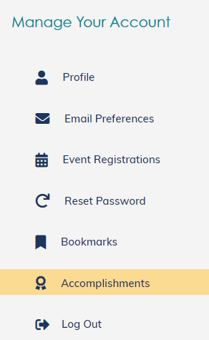
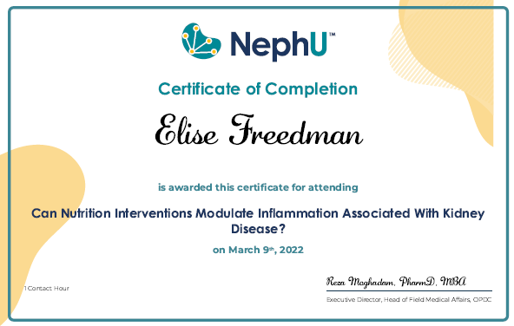
Thanks For Attending!
Don’t Forget To Download Your Certificate Of Completion On NephU.org Under
Your Account Within The Accomplishments Section
Your Name Here
Notes:
Speak to slide

Slide 19
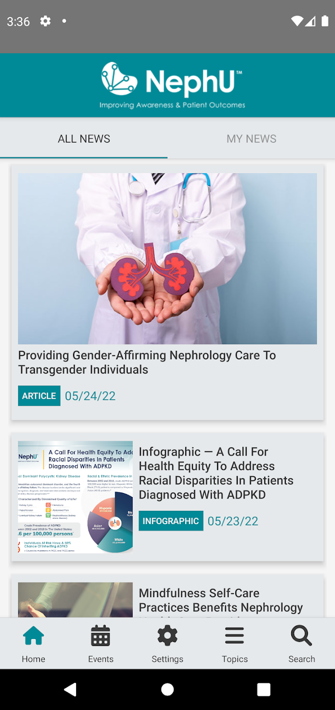
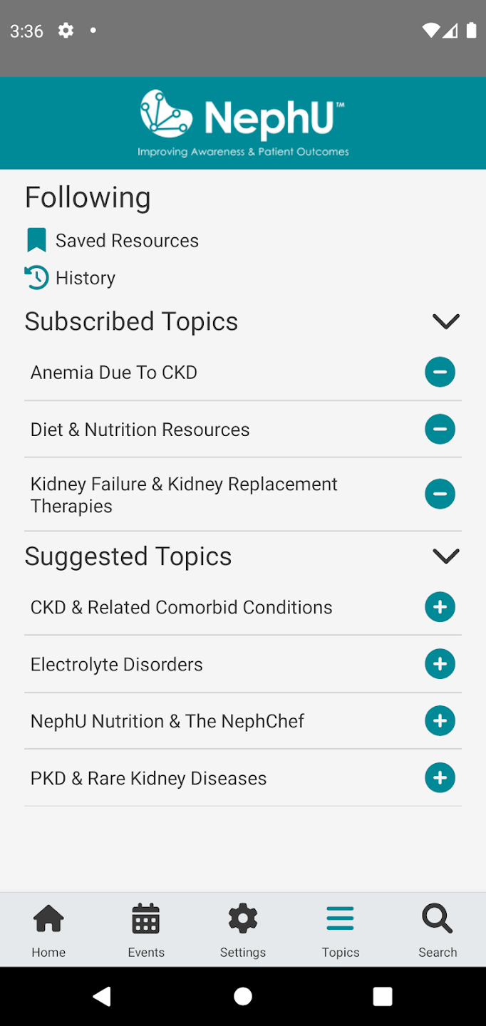
Download The NephU Mobile App Today!
All of Your Resources In One Spot
✓Videos
✓ On-Demand Webinars
✓ Podcasts
✓ Infographics
✓ Kidney-Healthy Recipes
Download the NephU App
from Google Play or from the
Apple App Store!
Notes:
Speak to slide

Slide 20
Presents
CKD/PKD-Friendly Recipe Deminar*
Dietitian Discussion Of PKD Dietary Recommendations Followed By A Cooking Demonstration
Featuring
Misty Nason,RD,CSR,CD & Chef Duane Sunwold
Moderated By
Molly Jansen,PhD
*Cooking Demonstration & Webinar
Notes:
Speak to slide.

